Slide 1
ArCoBotics Learn | Create | Share www.arcobotics.com
Basic Circuit

Slide 2
Basic Symbols of Circuits

Slide 3
BULB
BATTERY
x1
BATTERIES
x2
BATTERIES
x3
WIRE
SWITCH
CLOSED
(ON)
SWITCH
OPEN
(OFF)
WIRES CROSSING
BUT NOT CONNECTED

Slide 4
M
A
V
~
ELECTRIC MOTOR
AMMETER
VOLTMETER
AC
VOLTAGE SOURCE
FUSE
RESISTOR
VARIABLE
RESISTOR
ELECTRIC
BELL

Slide 5
Lets make a simple circuit

Slide 6
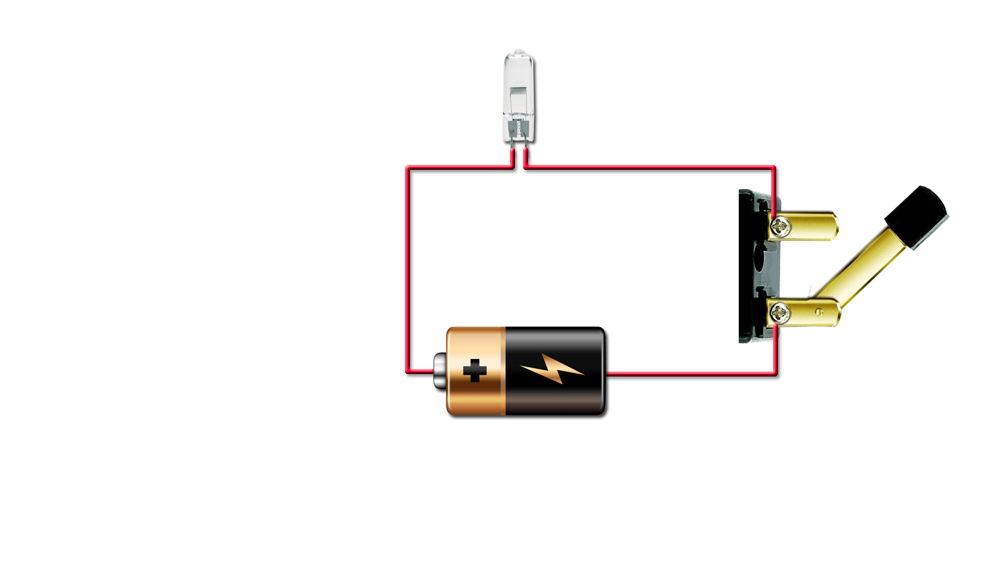


BULB
WIRE
BATTERY
SWITCH
Click on Switch

Slide 7
How to use this circuit ?

Slide 8
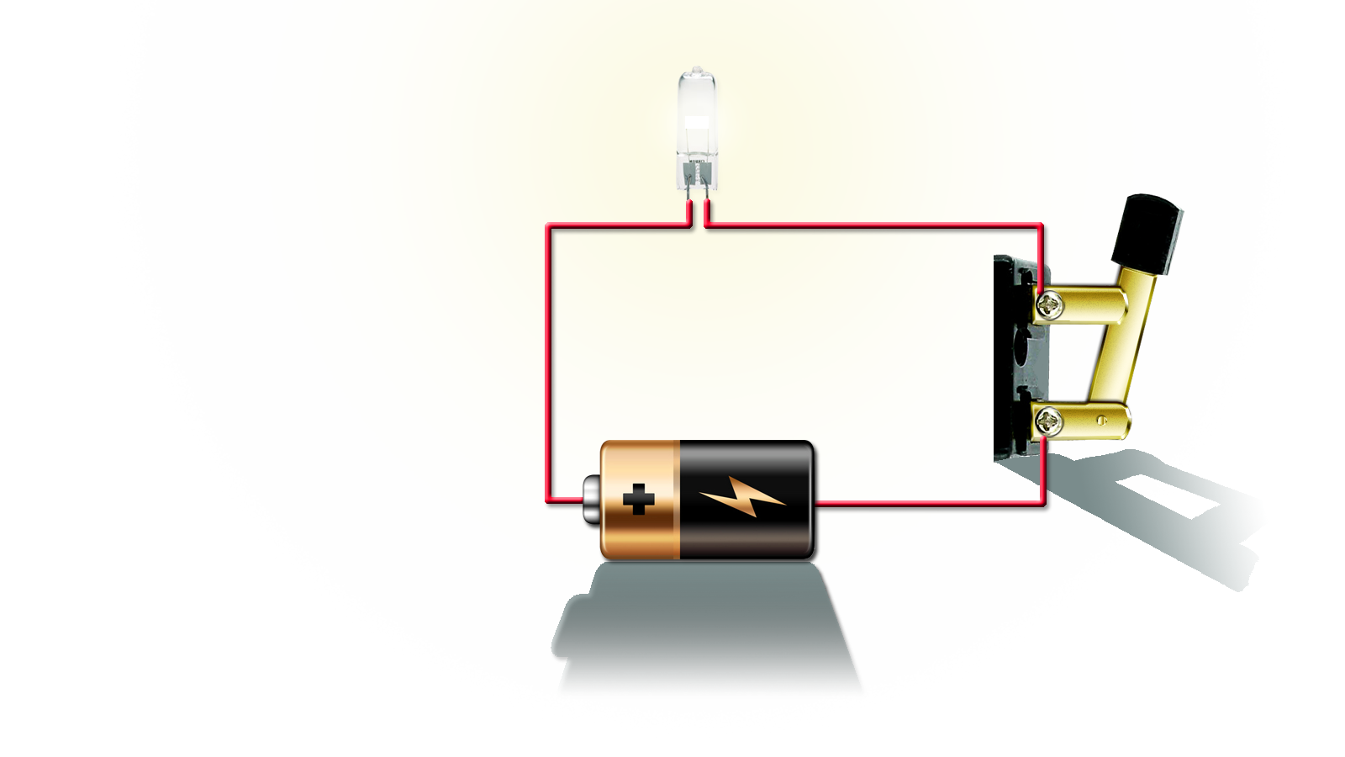
BULB
WIRE
BATTERY
SWITCH

Slide 9
Serial Connection

Slide 10


Serial Connection
Parallel Connection

Slide 11
Short Circuit

Slide 12
Also Short Circuit But Working

Slide 13
Where this Circuit is used?
~

Slide 14
Where this Circuit is used?
~

Slide 15
Main Switch
~

Slide 16
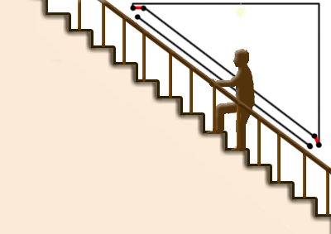
Two Way Switch Circuit
1
2
1
2
~
~
~
~

Slide 17
TWO way Design
TWO way Design

Slide 18
To remove content please request to dhruvsaidava@gmail.com

